Slide 1
Key Driver Analysis
A study and a method to implement it

Slide 2
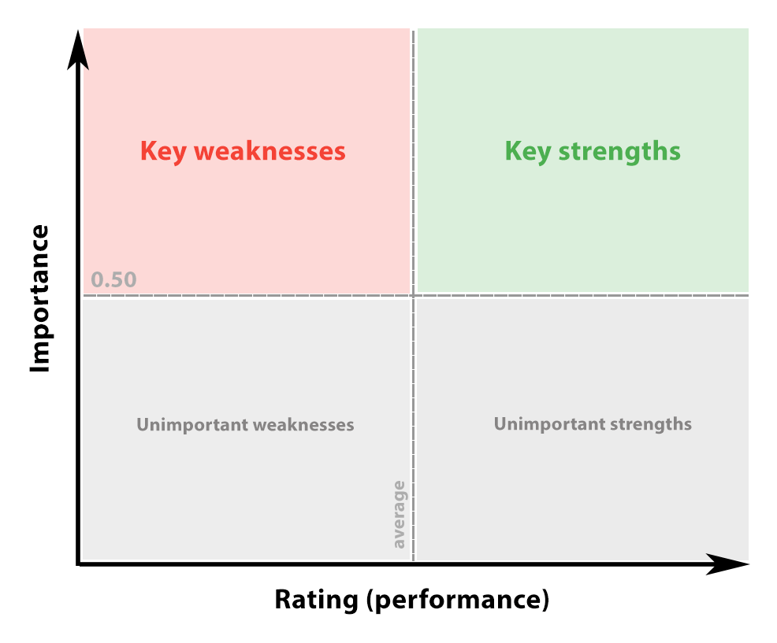
What is?
A key driver analysis (KDA) examines the relationships between potential drivers and behavior such as likelihood of positive recommendation or overall satisfaction.
Example of a plotted KDA
Notes:
Alterar o gráfico para atender o nosso cenário
Como podemos ler o nosso gráfico (usando dados reais | Jetson / Midea)

Slide 3
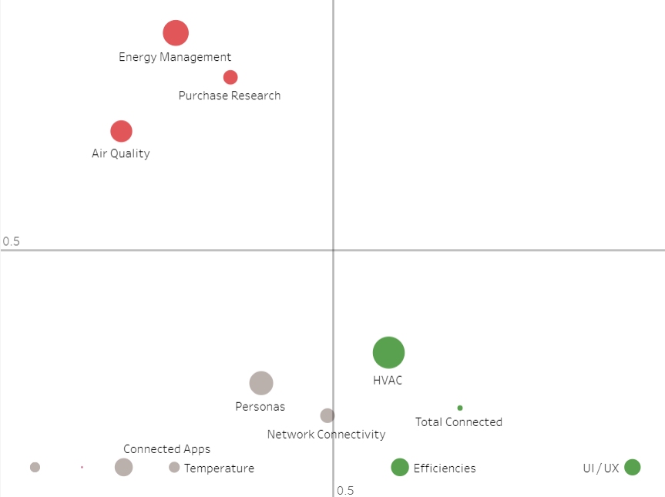
What is?
A key driver analysis (KDA) examines the relationships between potential drivers and behavior such as likelihood of positive recommendation or overall satisfaction.
Weaknesses
Critical Attributes
Negative relevance (Weakness)
Low Impact
Strengths
Positive relevance (Strength)
Example of a plotted KDA

Slide 4
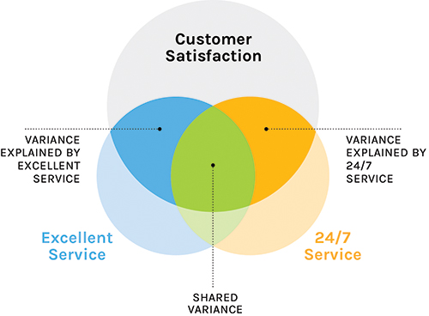
How KDA works?
It works by using multiple linear regression to investigate the correlations between independent variables (potential drivers) to generate the best linear combination to explain a dependent variable (the outcome metric).
In the example, the correlation will be calculated between “excellent service” and “24/7 service” trying to understand which one drives customer satisfaction.

Slide 5







RWA - Building KDA
RWA stands for Relative Weight Analysis
Method created by J.W. Johnson (2000) which through complex calculations quantifies the relative importance of correlated predictor variables in regression analysis.
To simply: it helps you figure out what variables contribute the most to the target
?
>
RWA
* - Multivariate Behavioral Research - A heuristic method for estimating the relative weight of predictor variables in multiple regression(https://doi.org/10.1207/S15327906MBR3501_1)

Slide 6
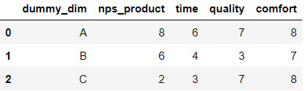
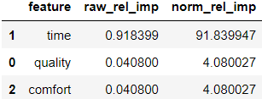
RWA Samples
Use cases
NPS Score
Dataset (sample)
Result( KDA )

Slide 7
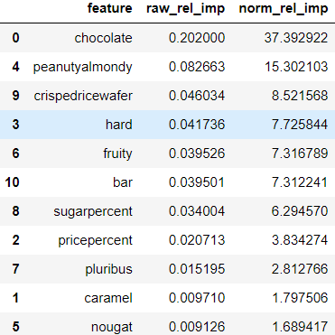
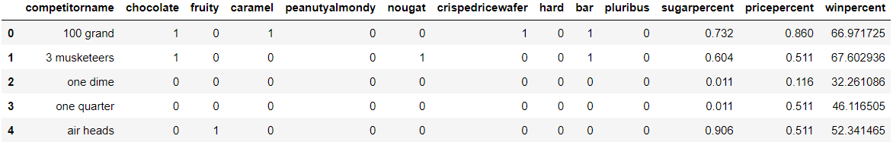
RWA Samples
Use cases
NPS Score
USA Chocolate
Result( KDA )

Slide 8
RWA Samples
Use cases
Chocolate
Dataset (sample)
Result( KDA )
* - Helps understand which flavors, formats and ingredients drives the preference of customers ( winpercent, in this example )

Slide 9
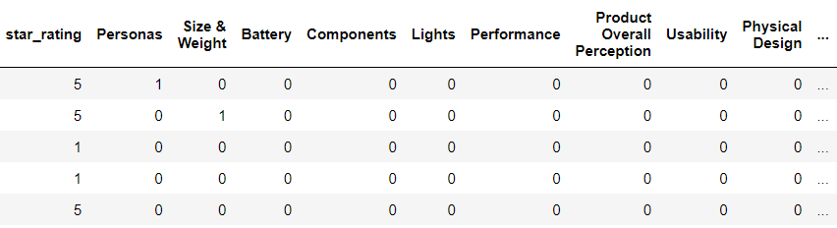
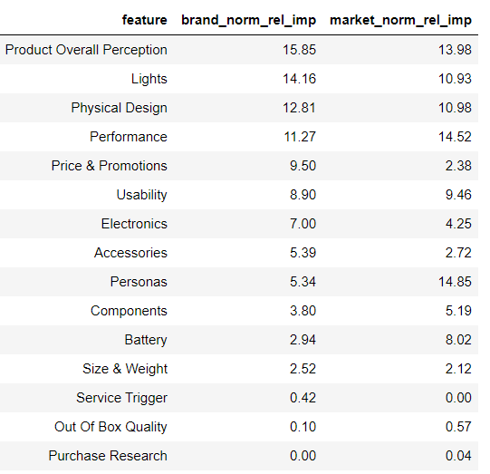
RWA algorithm
Use case
Jetson
Category: Hoverboard
Period: Feb, 2022
Method: Positive
Dataset
Result( KDA )

Slide 10
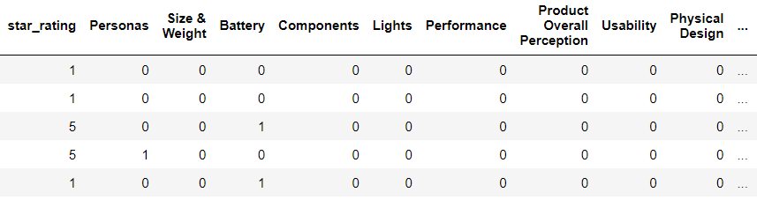
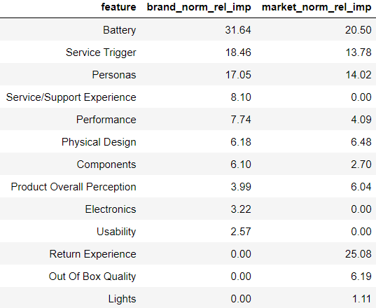
RWA algorithm
Use case
Jetson
Category: Hoverboard
Period: Feb, 2022
Method: Negative
Dataset
Result( KDA )

Slide 11
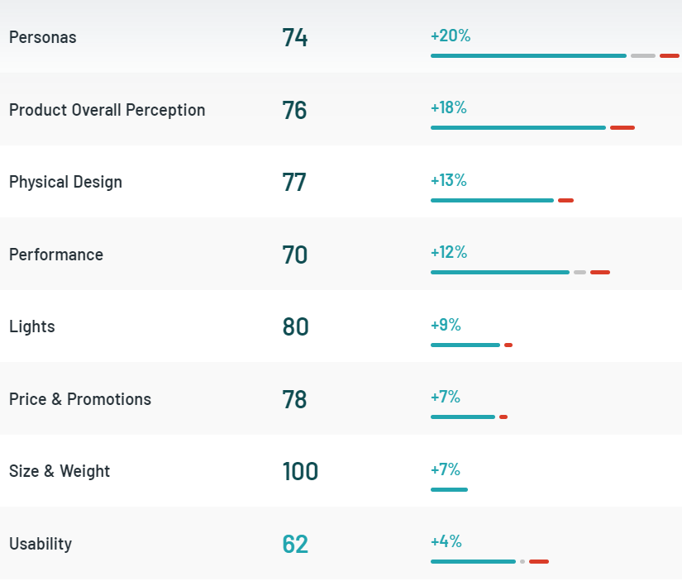
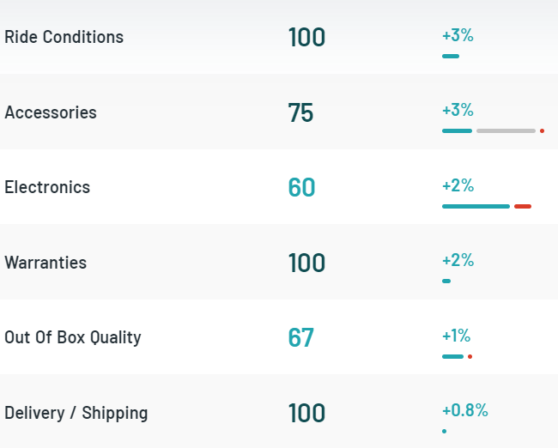
RWA x Impact Metric
Feature positive relevance - Jetson Hoverboards Feb 2022
Feature | Brand (+) (%) | Market (+) (%)
Product Overall Perception | 15.9 | 14.0
Lights | 14.2 | 10.9
Physical Design | 12.8 | 11.0
Performance | 11.3 | 14.5
Price & Promotions | 9.5 | 2.4
Usability | 8.9 | 9.5
Electronics | 7.0 | 4.3
Accessories | 5.4 | 2.7
Personas | 5.3 | 14.9
Components | 3.8 | 5.2
Battery | 2.9 | 8.0
Size & Weight | 2.5 | 2.1
Service Trigger | 0.4 | 0.0
Out Of Box Quality | 0.1 | 0.6
Return Experience | 0.0 | 0.0
Service/Support Experience | 0.0 | 0.0
Purchase Research | 0.0 | 0.0

Slide 12
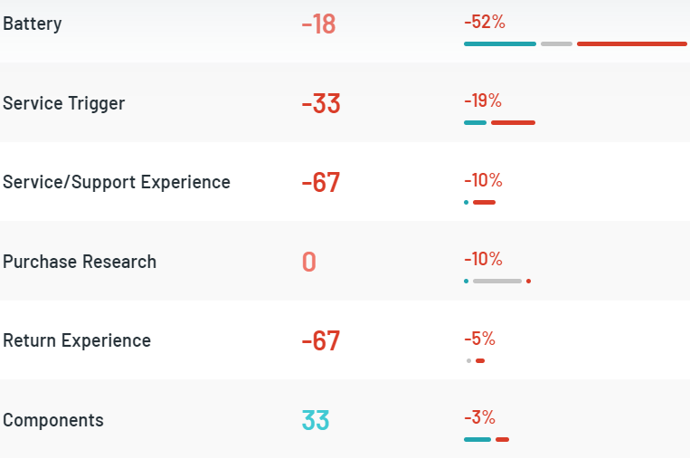
RWA x Impact Metric
Feature negative relevance - Jetson Hoverboards Feb 2022
Feature | Brand (-) (%) | Market (-) (%)
Battery | 31.9 | 20.5
Service Trigger | 18.6 | 13.8
Personas | 16.7 | 14.0
Service/Support Experience | 7.6 | 0.0
Performance | 6.9 | 4.1
Physical Design | 6.4 | 6.5
Components | 5.6 | 2.7
Product Overall Perception | 4.3 | 6.0
Electronics | 2.8 | 0.0
Usability | 0.7 | 0.0
Return Experience | 0.0 | 25.1
Out Of Box Quality | 0.0 | 6.2
Lights | 0.0 | 1.1
Price & Promotions | 0.0 | 0.0
Accessories | 0.0 | 0.0
Size & Weight | 0.0 | 0.0
Purchase Research | 0.0 | 0.0

Slide 13
Comparisons - RWA x Impact
Usage overview
Topic | RWA | Impact | Note
Attribute Segmentation | ✔ | ✔ | Products attributes can be evaluated separately. In RWA, the analysis can be done climbing or descending the dataset hierarchy ( Taxonomy group, Entity group, Detail group & etc )
Positive & Negative | ✔ | ✔ | Both methods evaluate the positive and negative detected sentiments of snippets
Comparison between Brands | ✔ | ✘ | RWA allows multi-comparisons between one or more brands in the same view
Resilience to review bias | ✔ | ✘ | RWA removes the interference effect that multiple snippets in the same review can cause boosting or hiding the importance of a feature to customers
Market Comparison | ✔ | ✘ | RWA allows comparisons between the brand and the market. What is more relevant to the brand? And to the market?
Allow Deltas | ✔ | ✘ | Deltas can be calculated between comparisons so it allow measures which features are more important to focus

Slide 14
RWA - Disclaimers
RWA requires always a single target quantitative column to run (in our cases, star rating)
Due to complex calculations performed by the algorithm, the more relevant (flagged) features the dataset has, more observations will be required to run without issues.
A good R2 score running RWA is relative as well. When working with real world data, most of the researchers consider 0.49 a good explainable score for model (considering a reasonable number of features)
The RWA can be tuned adjusting the invariance threshold to a lower percentage (the default is 3%), but a safe limit is 1%. The tuning process is recommended only to understand the minor fractions of the dataset that can be slipped out of the highlights.

Slide 15
How it contributes to our goals?
Golden Circle
KDA (RWA)
Why do we exist?
To make every customer voice heard in their relationships with brands
How we do it?
By enabling companies’ ability to generate and maximize value from available customer opinions at scale
What are we doing?
A SaaS platform that maps and quantifies the voice of consumer to support data exploration and insights generation along the product lifecycle of consumer facing companies
Focus the target on customer satisfaction (star rating) and what they mention in their reviews
Uses complex calculations to understand the sentiment detected by the enrichment team that contributed the most to customer satisfaction and/or dissatisfaction
Can be escalated and generate quick insights towards product improvement and market comparisons/positioning

Slide 16
Thank you!
Rafael Ribeiro
Data Scientist
rafael.ribeiro@birdie.ai
Notes:
Incluir Slide de benefícios do RWA em relação ao Impacto (pros e contras)
Brand x Market (Segmento)
Brand x All Others (Market - Brand)
Brand x Brand
Brand x Brand x Market
& Etc
Normalização da volumetria dos snippets dentro do Review (Tira viés da frequência de snippets no mesmo Review)
Remover R2 Score dos slides (OK)
Ocultar Technical Disclaimers (OK)
Colocar Delta nas análises:
Brand x Market
Brand x Concorrente
Positivo x Negativo

